Slide 1
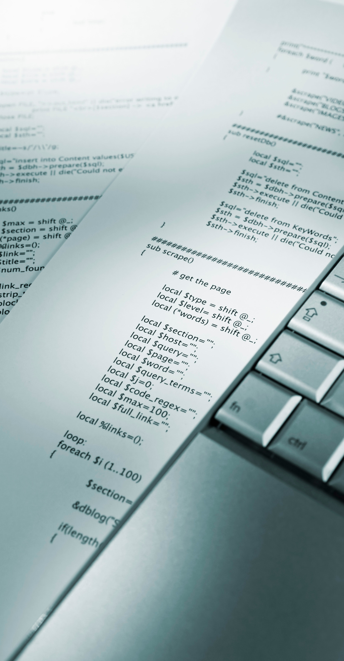
ITE61
INTRO TO ENTERPRISE SYSTEMS

Slide 2
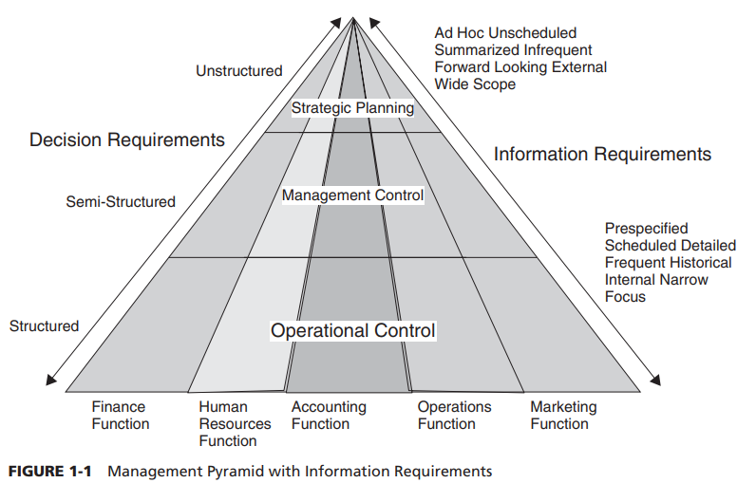
ITE61
ENTERPRISE SYSTEMS IN ORGANIZATIONS
Management is generally categorized into three levels: strategic, middle or mid-management, and operational.

Slide 3
ITE61
Information Silos and System Integration
The role of information systems has been and always will be one of supporting business activities and enhancing the workers, efficiency. Over time, however, as business changes and expands, systems need to change to keep pace.
Organizations need to be agile and flexible, and will require the same from their information systems. These systems need to have integrated data, applications, and resources from across the organization.
To compete effectively in today’s market, organizations have to be customer focused and cost efficient. This demands cross-functional integration among the accounting, marketing, and other departments of the organization

Slide 4

ITE61
ERP
ERP systems are comprehensive software applications that support critical organizational functions.
ERP system’s goal is to make information flow be both dynamic and immediate, therefore increasing the usefulness and value of the information.
Another goal of ERP system is to integrate departments and functions across an organization onto a single infrastructure that serves the needs of each department.

Slide 5
ITE61
Evolution of ERPs
During the 1960s and 1970s, most organizations designed silo systems for their departments
The efficiencies generated with these systems saw their expansion to the manufacturing area to assist plant managers in production planning and control. This gave birth to material requirements planning (MRP) systems.
Later, the manufacturing resources planning (MRP II) version was introduced in the 1980s with an emphasis on optimizing manufacturing processes by synchronizing the materials with production requirements.

Slide 6
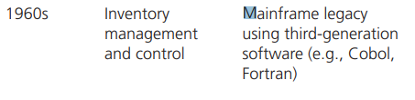
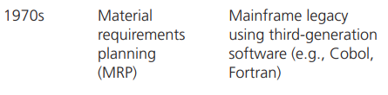
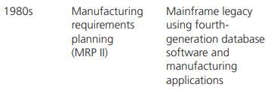
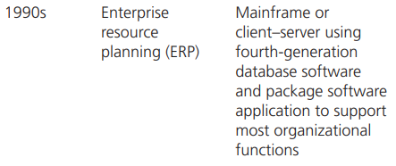
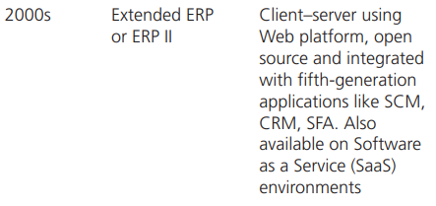
Evolution of ERPs

Slide 7
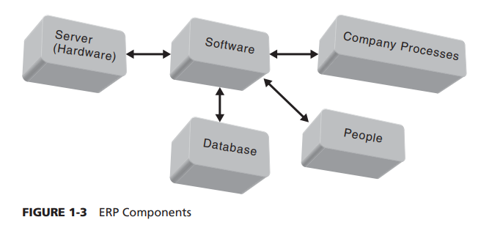
ITE61
ERP System Components
An ERP system, like its information system counterpart, has similar components such as hardware, software, database, information, process, and people.

Slide 8
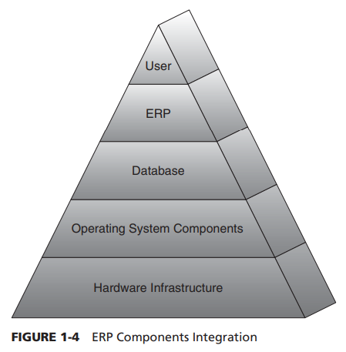
ITE61
Each component must be layered appropriately and each layer must support the efficiency of the other layers.
The layered approach also provides the ability to change layers without significantly affecting the other layers

Slide 9

ITE61
ERP Architecture
The architecture of the ERP implementation influences the cost, maintenance, and the use of the system. A flexible architecture is best because it allows for scalability as the needs of the organization change and grow.
The process of designing ERP system architecture is slightly different from other IT architectures. Whereas other IT architectures are driven by organizational strategy and business processes, if purchased, ERP architecture is often driven by the ERP vendor. This is often referred to as package-driven architecture.
A system’s architecture is a blueprint of the actual ERP system and transforms the high-level ERP implementation strategy into an information flow with interrelationships in the organization.

Slide 10
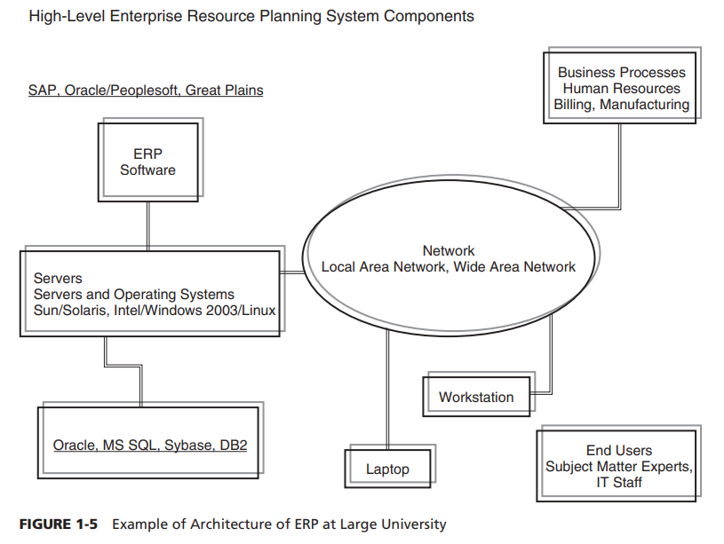
ITE61
ERP Architecture
An ERP package can have a very different implementation outcome from one organization to another
The architecture sets the stage for modifications or customizations to support an organization’s policies and procedures, data conversion, system maintenance, upgrades, backups, security, access, and controls.

Slide 11
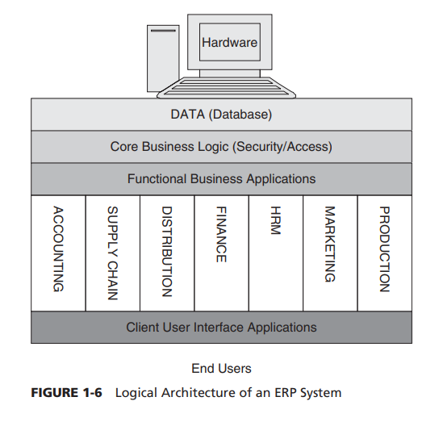
ITE61
Logical Architecture
The logical architecture focuses on supporting the requirements of the end users

Slide 12
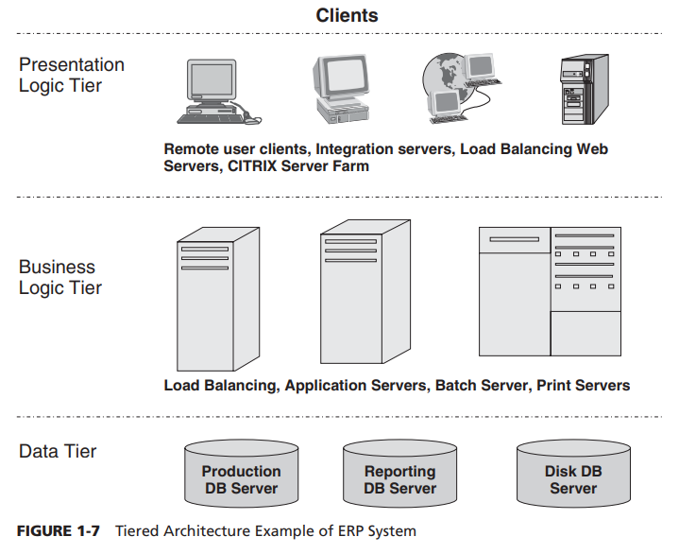
ITE61
Logical Architecture
The end users do not ever see the first and second tiers because they interact primarily with the client–user interface application tier that provides them access to the functional applications.

Slide 13
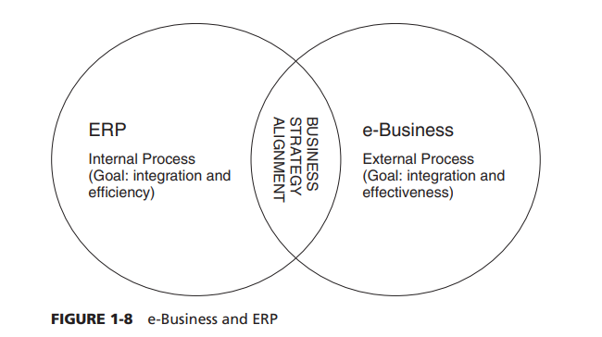
ITE61
e-Business and ERP
e-Business technology focus has been on linking a company with its external partners and stakeholders, whereas ERP focus has been on integrating the functional silos of an organization into an enterprise application
e-Business is a disruptive technology, whereas ERP is adaptive technology. e-Business practically transformed the way business operates in terms of buying and selling, customer service, and its relationships with suppliers.
The early focus of e-Business was on communication (e-mail), collaboration (calendaring, scheduling, group support), marketing and promotion (Web sites), and electronic commerce

Slide 14
Integration of data and applications across functional areas of the organization (i.e., data can be entered once and used by all applications in the organization, improving accuracy and quality of the data).
ITE61
System Benefits and Limitations of ERP
Maintenance and support of the system improves as the IT staff is centralized and is trained to support the needs of users across the organization.
Consistency of the user interface across various applications means less employee training, better productivity, and cross-functional job movements.
Security of data and applications is enhanced due to better controls and centralization of hardware, software, and network facilities.
Complexity of installing, configuring, and maintaining the system increases, thereby requiring specialized IT staff, hardware, network, and software resources.
Consolidation of IT hardware, software, and people resources can be cumbersome and difficult to attain.
Data conversion and transformation from an old system to a new system can be an extremely tedious and complex process.
Retraining of IT staff and personnel to the new ERP system can produce resistance and reduce productivity over a period of time.

Slide 15
Increasing agility of the organization in terms of responding to changes in the environment for growth and maintaining the market share in the industry.
ITE61
Business Benefits and Limitations of ERP
Sharing of information across the functional departments means employees can collaborate easily with each other and work in teams.
Linking and exchanging information in real time with its supply chain partners can improve efficiency and lower costs of products and services.
Quality of customer service is better and quicker as information flows both up and down the organization hierarchy and across all business units.
Efficiency of business processes are enhanced due to business process reengineering of organization functions.
Retraining of all employees with the new system can be costly and time consuming.
Change of business roles and department boundaries can create upheaval and resistance to the new system.
Reduction in cycle time in the supply chain from procurement of raw materials to production, distribution, warehousing, and collection

Slide 16

ITE61
ERP Implementation
Business Process Management
Business process management is the understanding, visibility, and control of business processes. A business process represents a discrete series of activities or tasks that can span people, applications, business activities, and organizations.

Slide 17
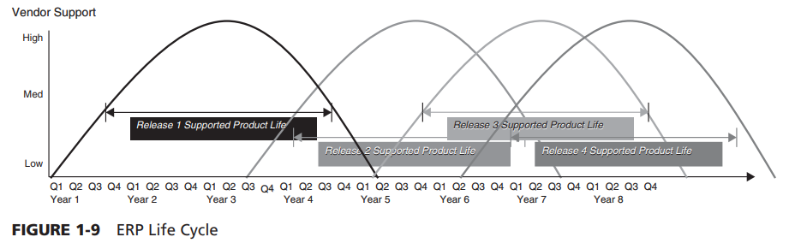
ITE61
ERP Life Cycle
The key to a successful implementation, therefore, is to use a proven methodology, to take it one step at a time, and to begin with an understanding of the ERP life cycle

Slide 18
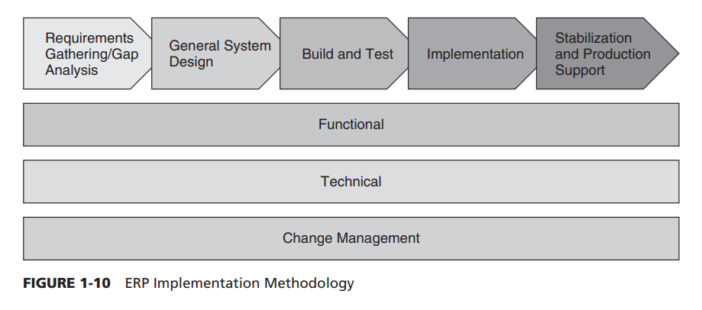
ITE61
ERP Implementation Strategies
Implementing an ERP system is problematic without first considering current business processes and changes to those processes based on the functionality of the new system.

Slide 19
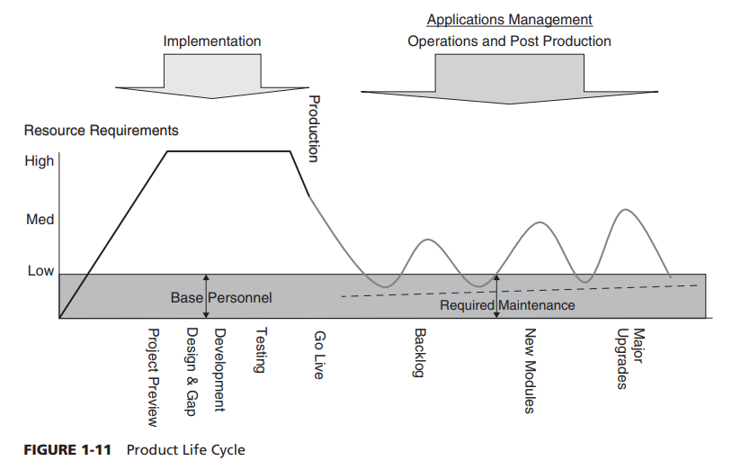
ITE61
Software and Vendor Selection
It is best for an organization that does not have the experience in developing ERP systems to purchase one; however, it does bring forward several issues that should be addressed.
ERP systems consist of computer applications that support and connect all aspects of an organization’s business processes and offer a link to customers and suppliers.
Before selecting a vendor, the organization must carefully evaluate its current and future needs in enterprise management systems.

Slide 20
ITE61
Operations and Post-Implementation
1. Training for end users
2. Reactive support
3. Auditing support to make sure data quality is not compromised by new system
4. Data fix to resolve data migration and errors that are revealed by audits
5. New features and functionalities to support the evolving needs of the organization
Going live (“Go-live”) is one of the most critical points in a project’s success. A lot of time and resources have been spent to get to this point.
Many ERP implementations have turned into disastrous endeavors during or after the Go-live stage.

Slide 21
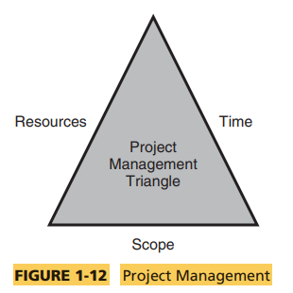
ITE61
Project Management
For an ERP system to be implemented successfully, project management must provide strong leadership, a clear and understood implementation plan, and close monitoring of the budget.
The role of the project manager is one of the most exciting yet risky jobs in an implementation. A successful project manager must be process driven and understand the value of an implementation methodology.
A key component to project management is to understand and communicate the ERP system application management life cycle.

Slide 22
ITE61
Role of Consultants
The use of consultants may appear to increase the project cost, but in most cases it does not. In the case where an organization does have the experience, the need for consulting should only be considered to address gaps in skills.

Slide 23
ITE61
Change Management
For major system implementations, the change management role is essential because it prepares an organization for changes to how its business is done. In implementing any new system, communicating, preparing, and setting expectations are just as important as training and supporting the implementation.

Slide 24

ITE61
Business Process Reengineering
Business process reengineering is often the case that current business processes will need to be changed to use the functionality of an ERP system fully.

Slide 25
ITE61
Global, Ethical and Security Management
There has been a widespread increase in corporate white-collar crimes such as unscrupulous accounting and marketing practices, privacy violations, unauthorized data sharing, spam mail, viruses, snooping, phishing, and identity theft.

Slide 26
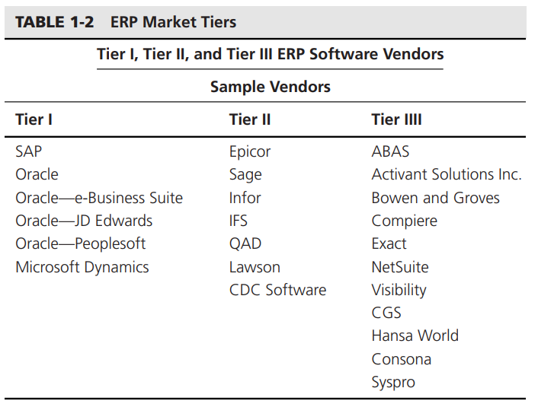
ITE61
ERP Vendors

Slide 27
ITE61
Key Vendors
SAP
Oracle
Infor
SAP is the recognized leader among ERP vendors, claiming the largest current market share. Its solutions are for all types of industries and for every major market.
Oracle is the first software company to develop and deploy 100 percent Internet-enabled enterprise software across its entire product line, which includes databases, business applications, and application development and decision support tools.
Infor delivers integrated enterprise solutions in supply chain, customer relationship and supplier management, workforce, asset management, product life cycles, operational and business performance, and more

Slide 28
ITE61
Key Vendors
Microsoft
Lawson
SSA Global
Microsoft Dynamics (MD) is a comprehensive business management solution built on the Microsoft platform. MD integrates finances, e-commerce, supply chain, manufacturing, project accounting, field service, customer relationships, and human resources.
Lawson provides industry-tailored software solutions that include enterprise performance management, distribution, financials, human resources, procurement, retail operations, and service process optimization.
SSA Global acquired Baan in 2004 and doubled the company’s size globally. They claim to offer solutions that accomplish specific goals in shorter time frames and are more efficient with time.

Slide 29
ITE61
Software Extensions and Threads
Intense competition and fluctuating sales have forced the ERP vendors to expanding their software functionality to add value and to support new organizational needs from compliance management, customer support, global supply chain, and such emerging technology platforms as open-source software (OSS) and service-oriented architectures (SOAs)

Slide 30
ITE61
IMPLICATIONS FOR MANAGEMENT
ERP systems implementation is a complex organizational activity.
ERP systems provide improved and added functionality for an organization.
ERP systems implementation requires strong project management oversight.
ERP systems are set to proliferate globally

Slide 31
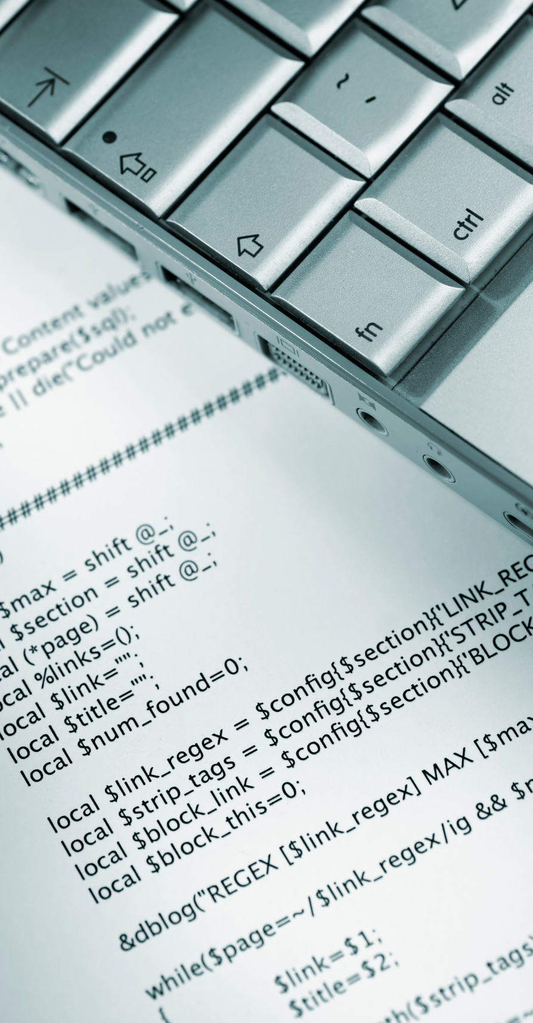
ITE61
Thank You For Your Attention!

